Slide 1

Fun Math Questions
1- Here are some fun, tricky and hard to solve math problems that will challenge your thinking ability.
If 1=3
2=3
3=5
4=4
5=4
Then, 6=?
Next>>

Slide 2
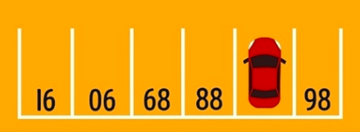

2- What is the number of parking space covered by the car?
This tricky math problem went viral a few years back after it appeared on an entrance exam in Hong Kong… for six-year-olds. Supposedly the students had just 20 seconds to solve the problem!
Back<<
Next>>

Slide 3
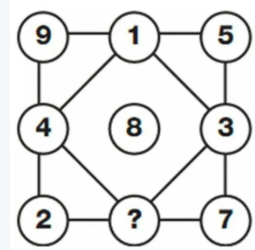

3-Replace the question mark in the above problem with the appropriate number.
Back<<
Next>>

Slide 4
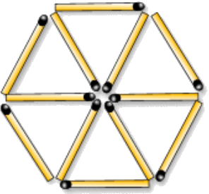



4- Move any four matches to get 3 equilateral triangles only (don’t remove matches)

Slide 5


5-Which number logically follows this series?
1. 7 9 5 11 4 15 12 7 13 8 11 ?
1)8
2)10
3)11
4)13

Slide 6

Correct answer
2

Slide 7

Answer:
Move 2, 4, 5, 6 matches

Slide 8

Answer:
6

Slide 9
Answer:
87
Question 2

Slide 10
Answer:
is 3, because ‘six’ has three letters
3
Question 1

